Slide 1


Data Storage Error Correction Accelerator for DNA memory
Dor Aviv and Sagi Freed
Supervisor: Dr. Amit Berman

Slide 2
Table of Contents
Problem Statement
Suggested Solution
Results
Discussion & Conclusion
DNA Memory Characteristics

Slide 3
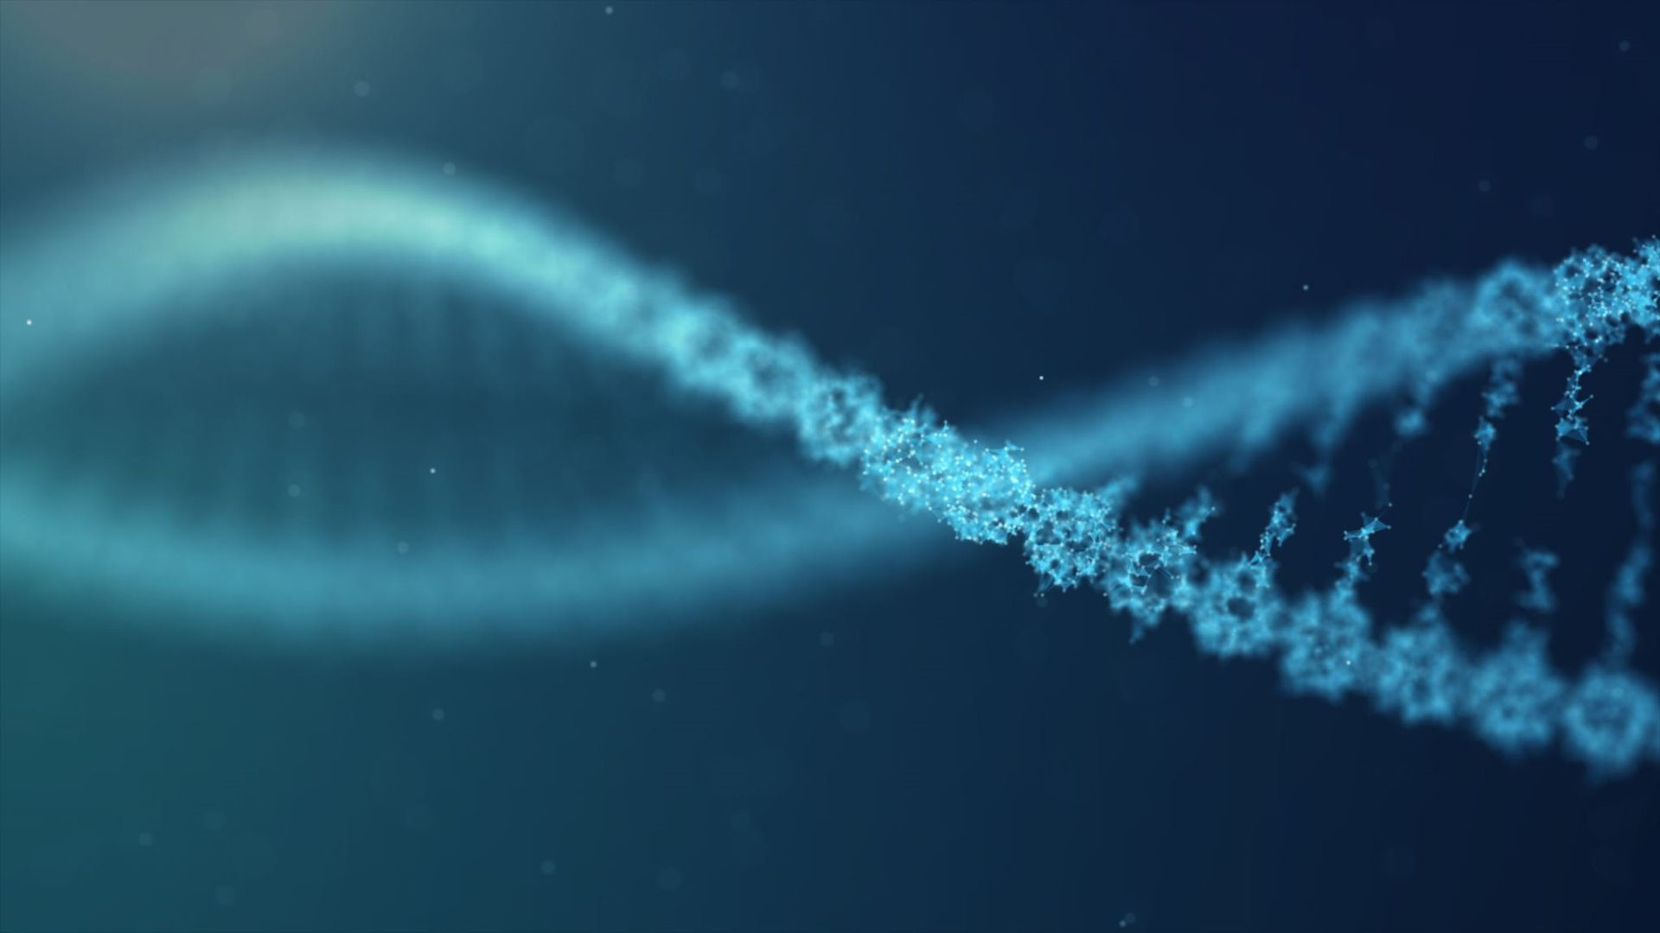

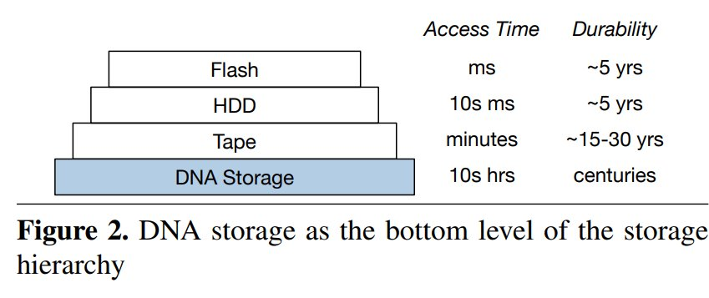
Problem Statement
DNA Memory (2012: CRISPR)
Potentially groundbreaking method to store information:
Extremely long durability
Extremely high-density
Cons:
Extremely long read-write times
Very high error rate
Requires a comprehensive error correction algorithm.
https://link.springer.com/chapter/10.1007/978-3-031-31775-0_54

Slide 4
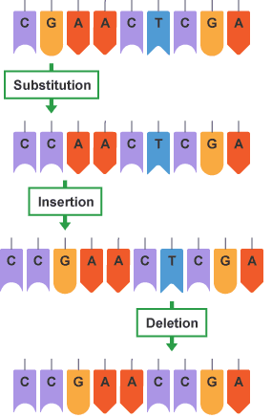
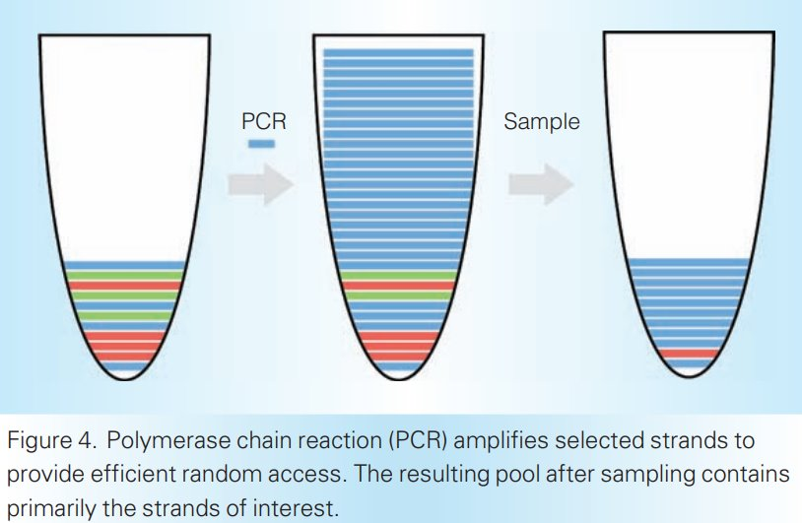
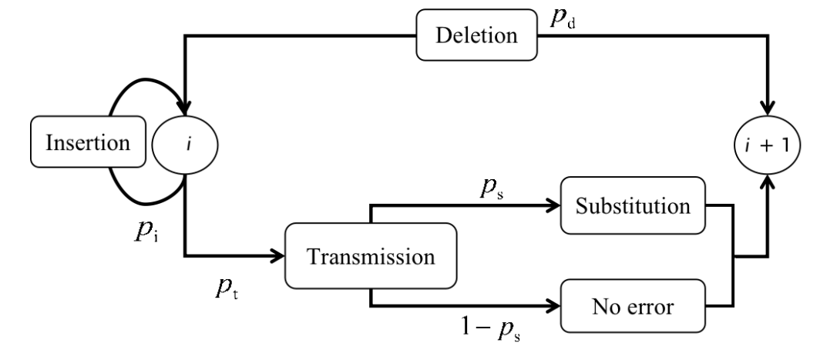
Memory Characteristics
IDS mutations
PCR reading​
Reading process duplicated desired strand out of the pool, samples several strands
Statistical dependency between strands can be used for higher recovery accuracy.
Code errors are generated via Insertion/Deletion/Substitution of nucleotides
Probability of each of the mutations can model the statistical dependency between bits.
Can be exploited by parity codes.
Deterministic decoders (for one error) are not sufficient.
https://www.bbc.co.uk/bitesize/guides/zc499j6/revision/3
https://www.semanticscholar.org/paper/Toward-a-DNA-Based-Archival-Storage-System-Bornholt-Lopez/8cdeb34a9f815b54c03607600bea2d242605d04c

Slide 5
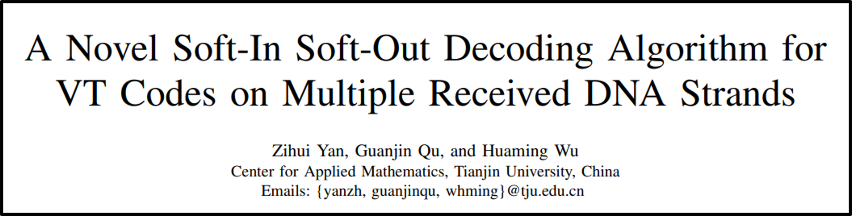
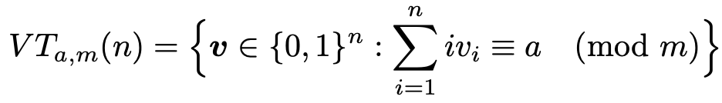
Suggested Solution
Based on paper:
SISO Decoding : Inputs and outputs are not 0/1 but rather probabilistic, based on multiple mutated strands.
VT (Varshamov-Tenengolts) Codes : Encoding all inputs into a set of codewords at length n which fulfill the condition
Encoding is done via inserting “parity” bits at $v_{2^{i}}$, which greatly increases redundancy.

Slide 6
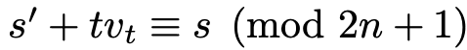
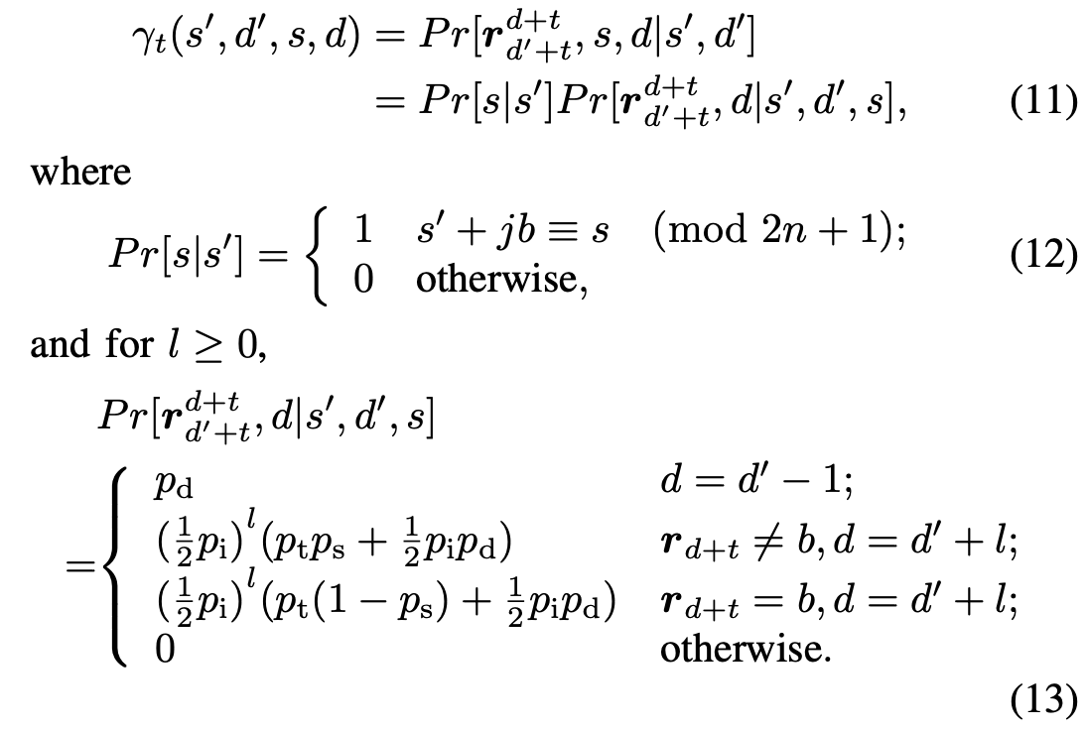
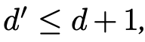
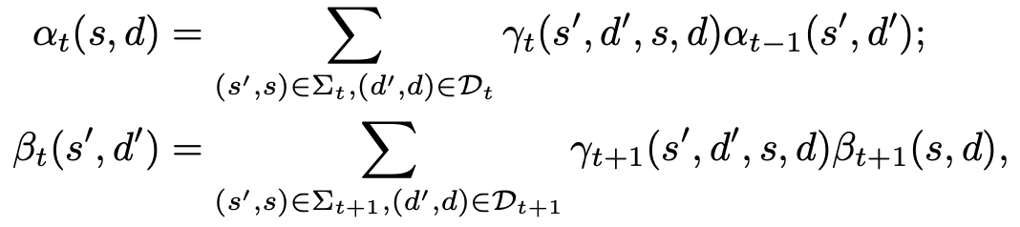
Suggested Solution
Algorithm steps:
Encoding Input: Given an input strand, encode it with a known (a) to become a VT code. Take note of encoded length.
Transmission: Apply IDS errors to strand to receive the corrupted VT code.
Transition Probabilities: define the current/previous syndrome (s) and the drift accumulation (d), and calculate via a forward/backward pass the transition probabilities for all combinations:

Slide 7
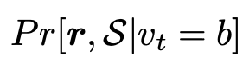
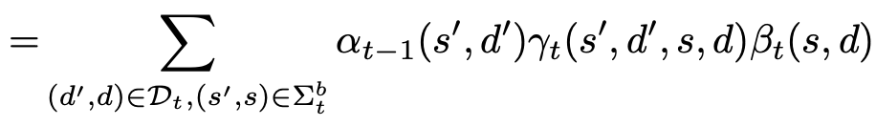
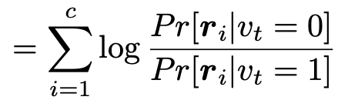
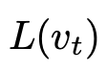
Suggested Solution
Algorithm steps:
4. Probability Calculation: the probability for any bit to be 0/1 is defined as the sum of all possible combinations leading up to it
5. Bit Likelyhood+Decoding: Summing all strand probabilities, the sign of the sum decides whether bit is 0 or 1.

Slide 8
Our Work
In this project we recreated the original paper’s model twice:
Once as a software simulation to check viability
Once as a hardware accelerator for fast performance

Slide 9
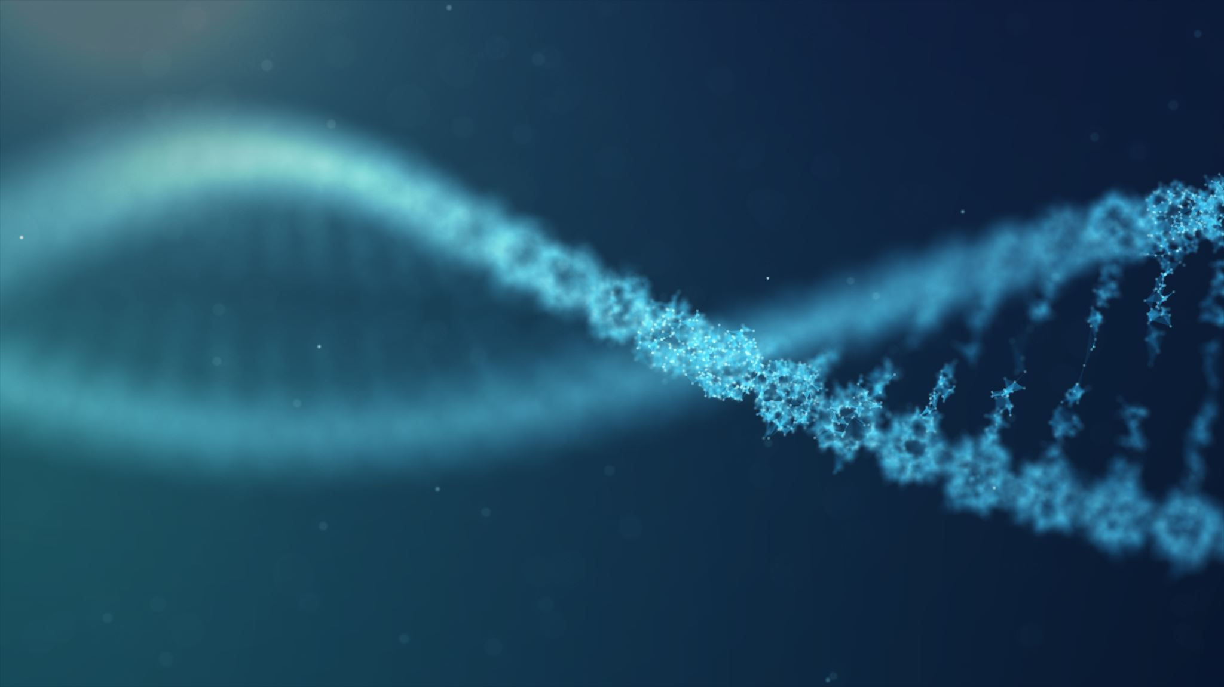

Logical Structure
011_0..
soft_
Soft decoding algorithm
011110..
01100..
01⅞⅚⅕..
0110..
0110..
DNA memory
decoder_
Decoding processing unit
VT_
Coding data to a VT code
IDS_
Error generating
hard_
Hard decoding algorithm
VT_
Return data
source
user
01110..

Slide 10

System Architecture
Software (Python)
Hard Decoder
VT Encoder
IDS errors
Output
Soft Decoder
Multi-Sequence
Alpha/Beta
Probability
Likelyhood
Hardware (SystemVerilog)
Multi
Strand memory
Hard Decoder
Output
Prob. memory
Soft Decoder
VT Encoder
IDS errors
VT Decoder
Alpha/Beta
Probability
Likelyhood
Processing Unit Controller

Slide 11
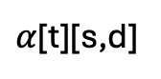
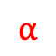
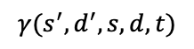
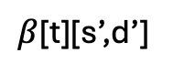
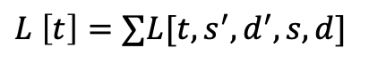
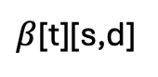
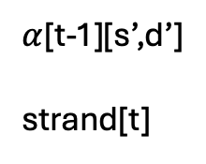
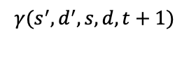
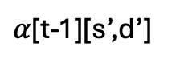

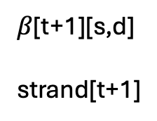
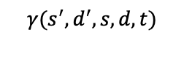
Hardware Soft Decoder
recursive_matrices
recursive_likelyhood
clk
clk
$α$[t-1][s’,d’]
strand[t]
$α$[t][s,d]
$$γ(s^{′},d^{′},s,d,t)$$
strand
strand
s,d
start
start
$α$[t-1][s’,d’]
$β$[t][s,d]
t,s’,d’,s,d
Likelyhood
$$L \left[t\right]=∑L[t,s^{′},d^{′},s,d]$$
Done
$β$[t+1][s,d]
strand[t+1]
$β$[t][s’,d’]
$$γ(s^{′},d^{′},s,d,t+1)$$
$$γ(s^{′},d^{′},s,d,t)$$
$$α$$
s’,d’
t
$$β$$
done

Slide 12
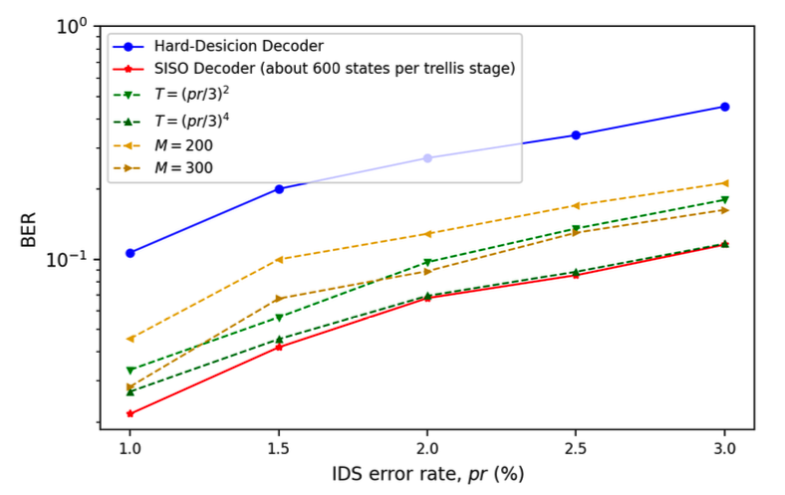
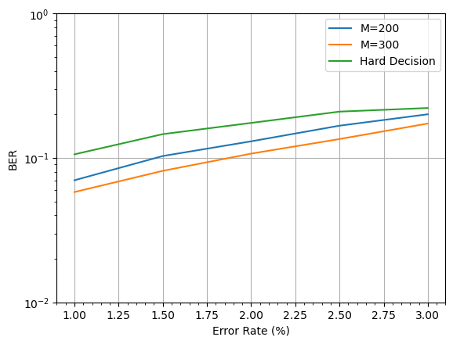
Results (Code)
BER (Bit-Error-Rate) for different models:
Paper Outcome
Our Result
Same trends, difference due to randomness and unknown method of BER calculation

Slide 13
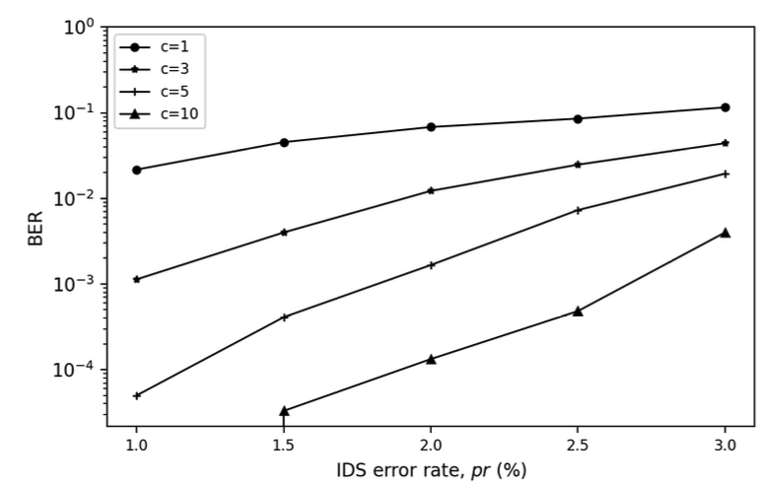
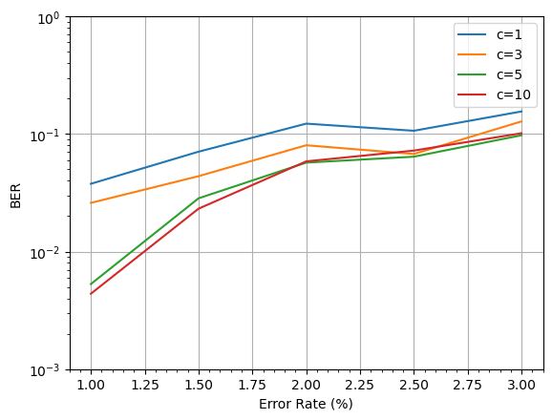
Results (Code)
BER (Bit-Error-Rate) for different # of strands:
Paper Outcome
Our Result
Similar trends. Our result is based on the M=200 model because of computation limitations. This and randomness/unknown method of BER calculation lead to different outcome.

Slide 14
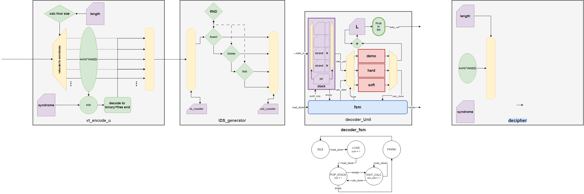
Processing Unit

Slide 15
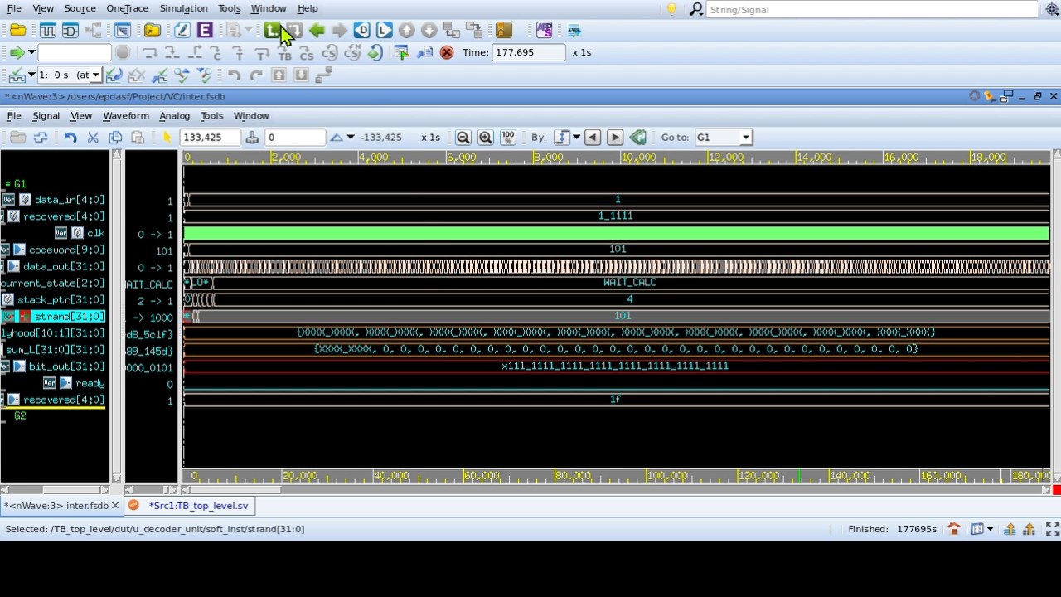
IN = 0001
VT = 0000000101
Mem & FSM
corrupted
Sum to bit
OUT = 0001

Slide 16
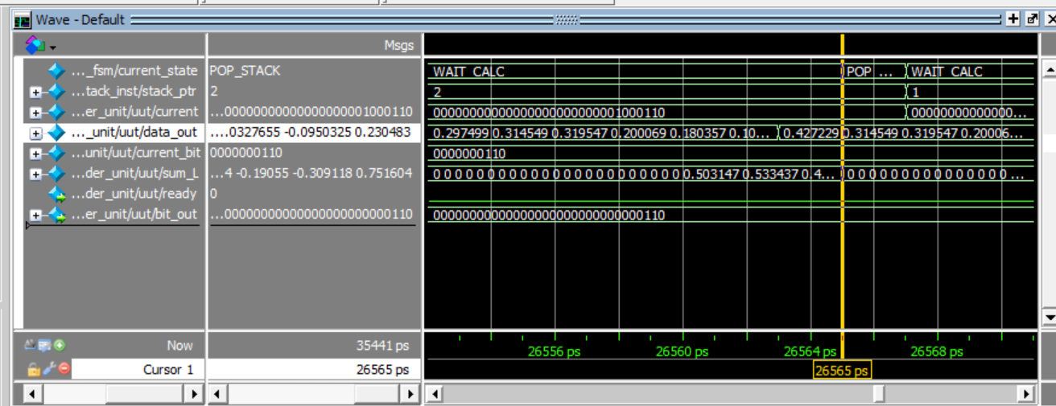
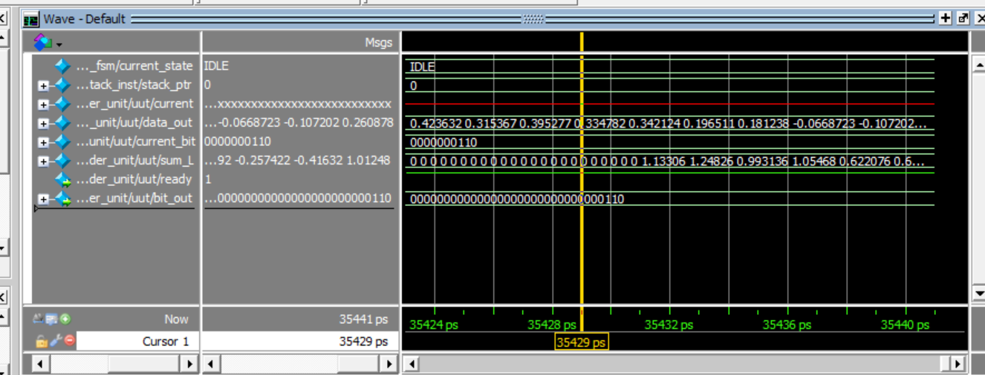
Hardware simulation

Slide 17
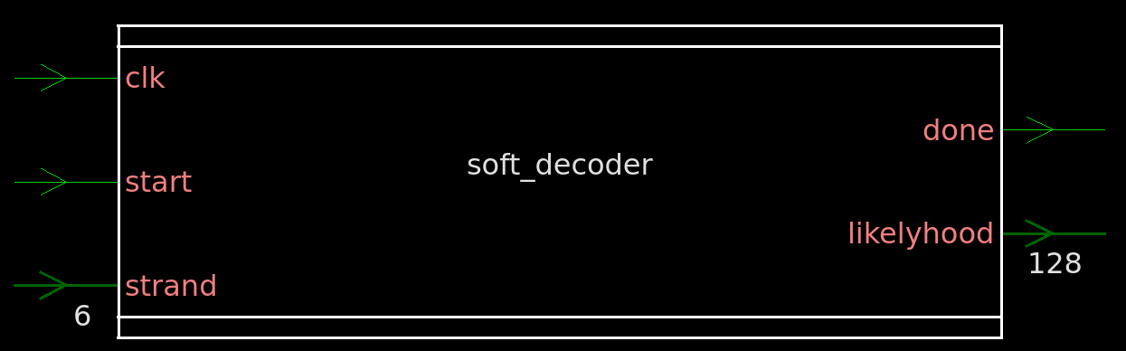
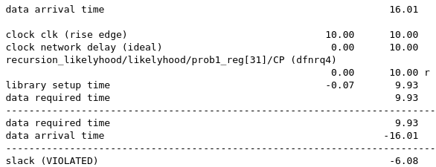
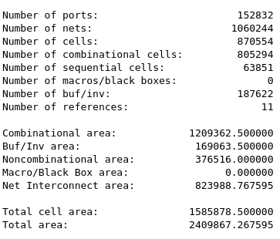
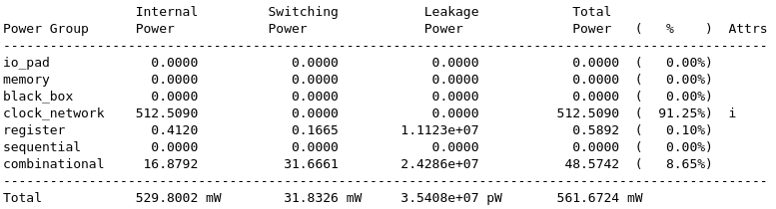
Results (Hardware)
Synthesis Example: SISO decoder module with n=4, N=4, a=0
Timing
Area
Power

Slide 18
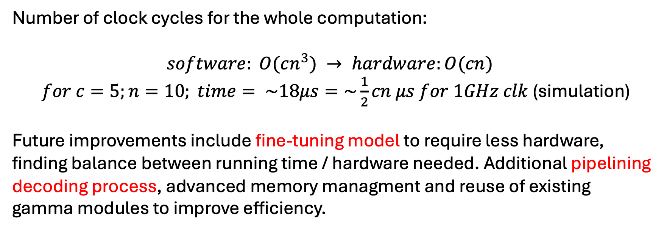
Results (Hardware)
Number of clock cycles for the whole computation:
$$software: O(cn^{3}) → hardware:O(cn)$$
$for c=5;n=10; time= \sim 18μs=\sim \frac{1}{2}cn μs for 1GHz clk$ (simulation)
Future improvements include fine-tuning model to require less hardware, finding balance between running time / hardware needed. Additional pipelining decoding process, advanced memory managment and reuse of existing gamma modules to improve efficiency.

Slide 19
Discussion & Conclusions
Challenges:
Paper has missing information and misleading equations.
Limited compute power (particularly for software simulations)
Limited time to create efficient hardware implementation
Software/Hardware needed completely different implementations.
Outcomes:
Recreated paper’s model and outcomes
Viable POC hardware accelerator.
Framework for future improvements.

